Slide 1
Partnerships for Learning
at O.L.D. in 2020
Year 2

Slide 2
Prayer and Reflection
Parents and Teachers
I dreamed I stood in a studio
And watched two sculptors there
The clay they used was a young child’s mind
And they fashioned it with care
One was a teacher, the tools he used
Were books and music and art
One was a parent with a guiding hand
And a gentle loving heart
Day after day the teacher toiled
With a touch that was deft and sure
While the parent labored by his side
And polished and smoothed it over
And when at last the time had passed
They were proud of what they had wrought
For the things they had moulded into the child
Could never be sold or bought
And each agrees they would have failed
If they had worked alone
For behind the parents stood the school
And behind the teacher, the home
Please take the time for silent prayer as we start our evening

Slide 3
Whole School Information
Embrace the Challenge in 2020!

Slide 4
Notes:
.

Slide 5
Class routines!
Each morning the classroom will be open at 8:15am.
Students are to place bags on the bag racks.
Take out their lunch box and drink bottle and put them on the fridge and the bench.
Hat in or on top of bags.
Communication folder in the shelf.
In year 2 we are seeking independence with our daily jobs.

Slide 6
Notes:
We started the year getting to know each other and for the students to reflect on what each element of our school rules and expectations mean.

Slide 7
Notes:
Exploring each key and what it means in our classroom. Students hear the language and are given modeled examples. As a school we focus on each key at different times

Slide 9
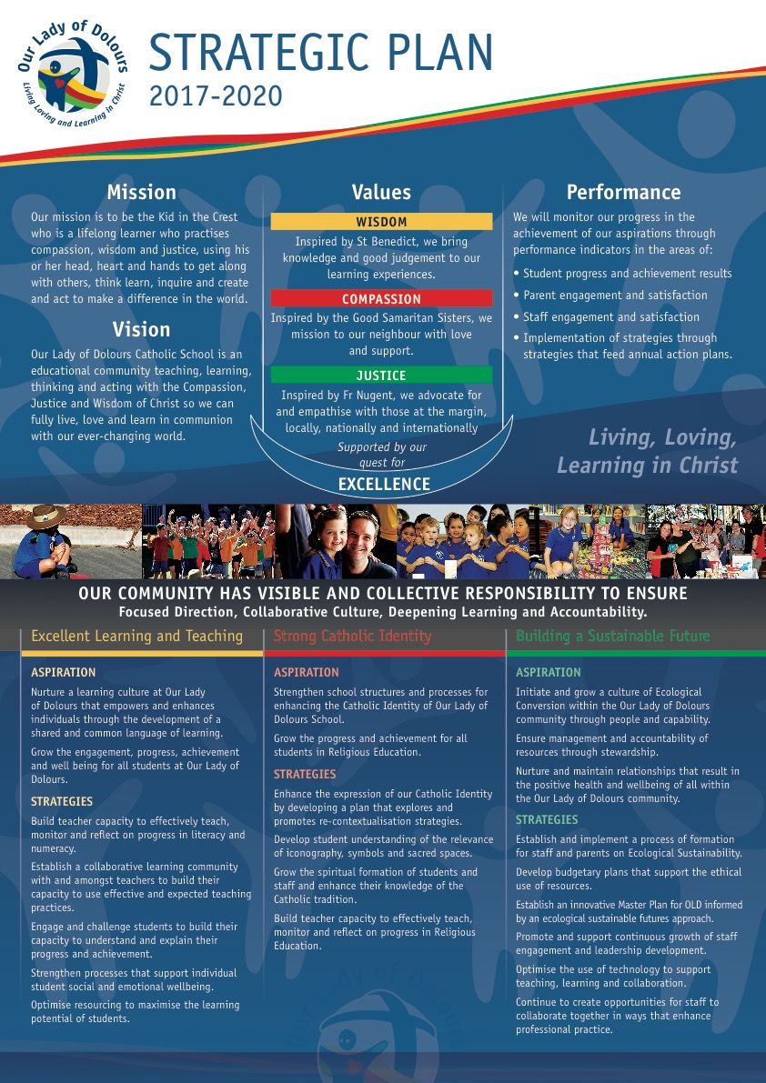

Slide 12
Key Learning Areas
Specialist Areas
Physical Education (PE) - Monday
Music – Wednesday
Visual Arts - (Term 1, 3) Monday
Japanese – Monday
Technology – (Term 2, 4) Thursday
Swimming Lessons- Mondays Term 1 weeks 3 – 5 and the carnival in week 6

Slide 13
Key Learning Areas
Australian Curriculum
English,
Mathematics,
Science,
HaSS (Humanities and Social Sciences)
Technology;
Health & Physical Education;
LOTE - Japanese
The Arts
Brisbane Catholic Education
Religious Education

Slide 16
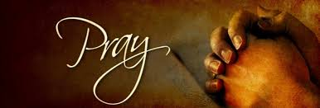
Religious Education
Follows the Brisbane Catholic Education Curriculum
Classroom Prayer experiences:
Participate with respect in a variety of personal and communal prayer experiences.
Creating a prayer space in the classroom – Prayer mat that has been designed by the students and enables the class to sit around this space for prayer – can be used indoors and outdoors.
Daily prayer as a part of our morning routine.
Explicit teaching of meditation skills including centred breathing, labyrinths, silence and stillness.

Slide 17
2020 – The Year of St Benedict

Slide 19
Meetings and Academic Reporting
Summative Reports (End of term 2, 4)
Parent/Teacher Meetings Term 1
Samples of work (Student Portfolio) Semester 1 and 2
Specialist Support Team Meetings: Guidance Councillor, Support Teacher of Inclusive Education (ST:IE) are available to meet and discuss individual supports and adjustments to learning if required.
Additional meetings on student progress or concerns are held at times that are suitable for both teacher and parents.

Slide 20
Guidance Counselling
Guidance Counsellor (GC)
Semester 1- Ms Ruth Blackburn
Semester 2 – Ms Melissa Ford
Can assist with a range of issues that might impact on learning, including:
Anxiety
Friendship/social skills
Grief and loss
Behavioural concerns
Learning difficulties

Slide 21
Parent Teacher Communication
All newsletters and forms are now accessed electronically and through the school portal or parent portal.
Office email communication pmitchelton@bne.catholic.edu.au
Teacher email cplater@bne.catholic.edu.au
Class blogs accessed from home page of school website
Term overviews
Homework
Calendar dates
Reminders
Pastoral parent: Ms Danielle Huffels
Volunteer training needs to be completed for excursions and classroom helpers.
At any stage throughout the year please feel free to contact me and make an appointment if you have any questions or concerns. The best way to contact me is through email. I will reply to all emails as soon as reasonable and within 48hrs.

Slide 22
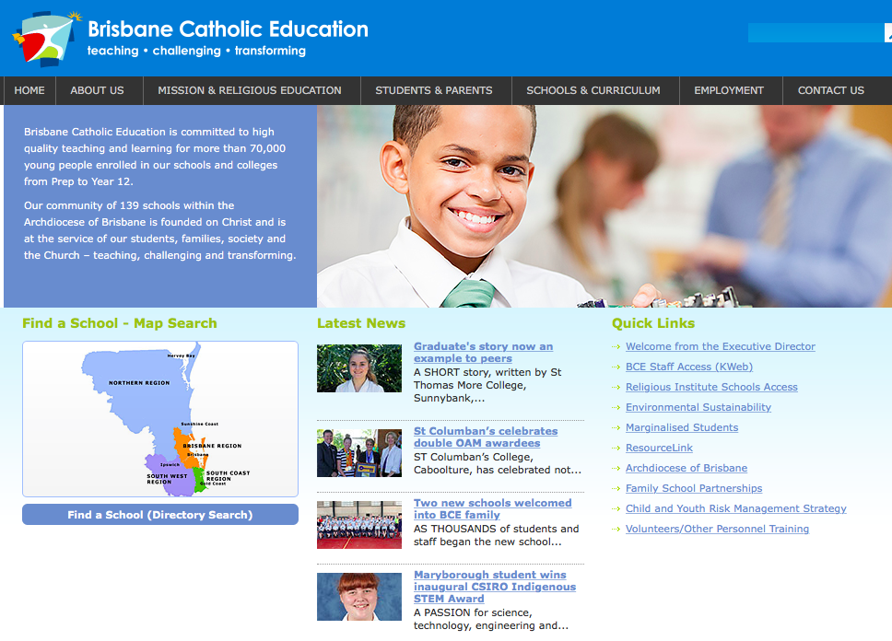
Volunteer Training

Slide 23
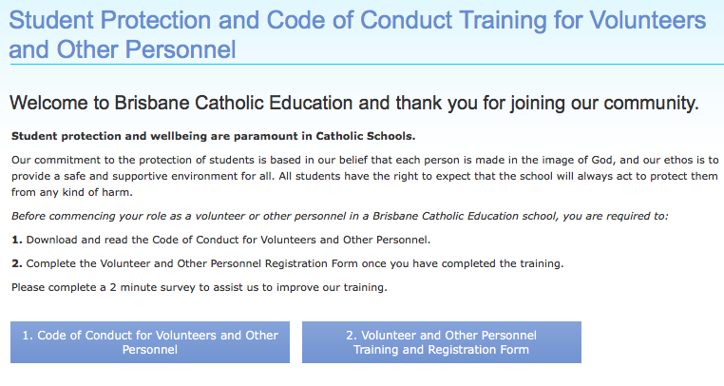
Volunteer Training

Slide 24
Homework
Accessed on the Class Blog
Approximately 10- 15 minutes of homework only
Importance of reading each day from a variety of texts.
Homework activities are given as a revision or continuation of activities completed in class. These activities should not cause your child stress or anxiety when completing tasks.
Please let me know if your child is having difficulty completing homework or if family commitments limit homework time.
We understand the busy lives of families and I am happy to adjust or add if needed.

Slide 25
Homework – How does it work?
Homework grid is uploaded to the class blog every Monday (starting week 4).
On the grid there are 2 shaded boxes marked with a star that are ‘must do’ for the week. Then students can choose 2 or boxes more from other learning areas.
Students will be given an exercise book to complete activities or glue in sheets if you decide to print. To save printing please write in the date and the title of the box completed.
Students are to return the homework book each Monday (week 5).
Home readers will be given out (starting Friday week 3) changed each Friday during Library borrowing.
Parents are to complete the reading log on the inside cover of the folder.

Slide 26
Timetable
Monday | Tuesday | Wednesday | Thursday | Friday
Visual Arts (terms 1,3) |  | Music lessons | Technology (terms, 2,4) | Library borrowing
Physical Education (P.E) |  |  |  | Homework readers changed
Japanese |  |  |  | Whole school assembly
Swimming (weeks 3-6)

Slide 27
Additional information
Student allergies- Nuts, dairy
Please ensure all students wash hands after breakfast and are not sharing food during breaks.
Student birthdays – cupcakes or ice blocks/creams (aware of allergies). Please note any freezer items will need to be labelled and placed in the Year 1 or Prep classroom freezers.
Absences from school – please email or call (07) 3355 7763​ pmitchelton@bne.catholic.edu.au
SMS notifications will be sent each morning when absence is unexplained.
Excursion will be advised during the year and will be based on curriculum topics. Parent helpers for all class or excursion help will be required to complete the volunteer training.

